Slide 1

Aroha Technology
Tableau Dashboards
Shailendra Yadav

Slide 2
Project Brief: Discount Mart
Objective
Discount mart is a small supermarket owned by grant frost. He wants a dashboard where he can track how well discount mart is doing for this year (in terms of sales, profit and quantity sold).
He would also like to know how well categories are performing as well as different regions.
Grant frost assumes that most customers buy 2 or more products per basket/order but would like this confirmed by the data.
Grant also noted that profit is 30% of the selling price.

Slide 3
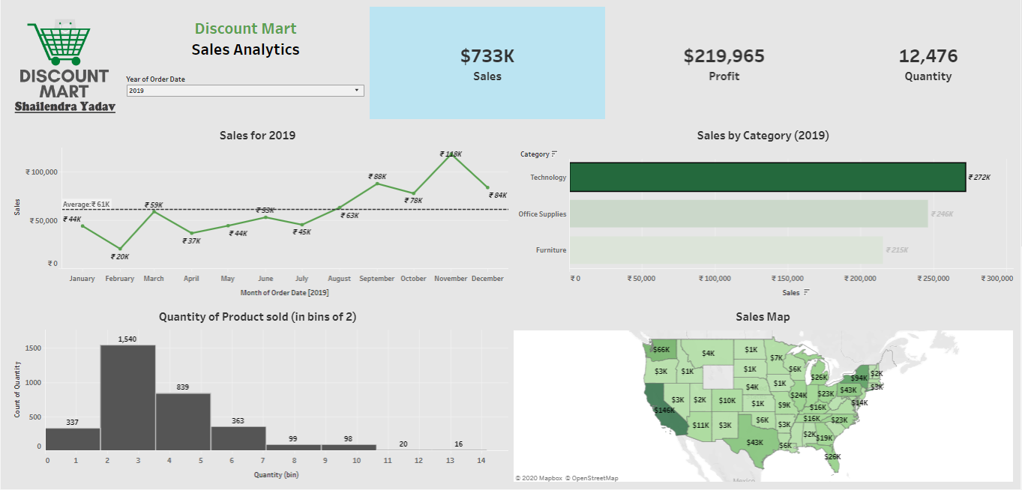

Slide 4
Project Brief: Green Destinations
Objective
Green destinations is a well known travel agency. The HR director has recently noticed an increase in employees leaving (attrition). She would like to figure out any trends or patterns. She has surveyed the staff of green destinations and provided you with the data.
She would like to know what the attrition rate is (% of people who have left).
She would also like to know if factors like age, years at the company and income play a part in determining if people will leave or not.

Slide 5
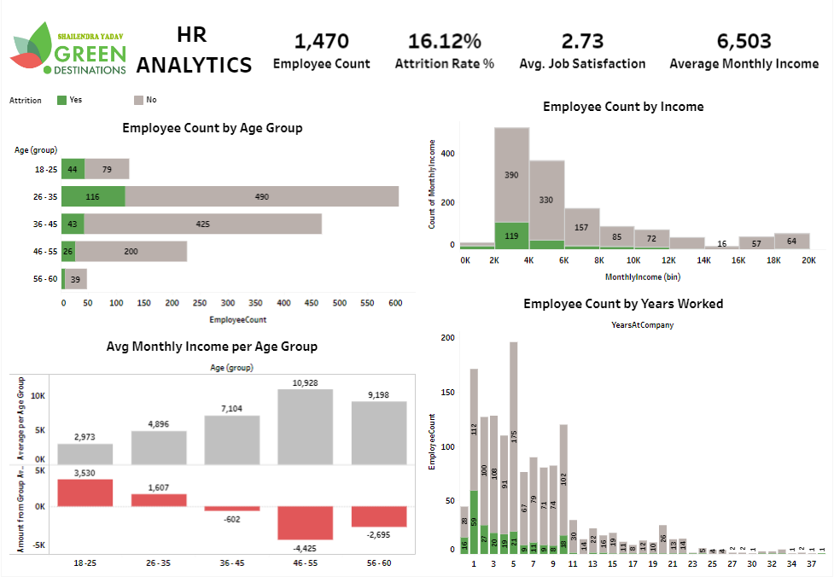

Slide 6
Project Brief: Superstore
Objective
Superstore is a famous retailer in canada. They have expanded into the USA and their business model involves placing sales agents in every state in the USA. These sales agents are responsible for bringing in sales for the state that they are assigned to.
The sales manager wants a dashboard to track how sales agents are doing. He wants it to be comparable where he selects a timeframe this year (example january - march 2020) and he wants sales data for the same period last year. This is so he can track growth.
Additionally, he wants a breakdown of sales per category and subcategory as well as the top performing products.

Slide 7
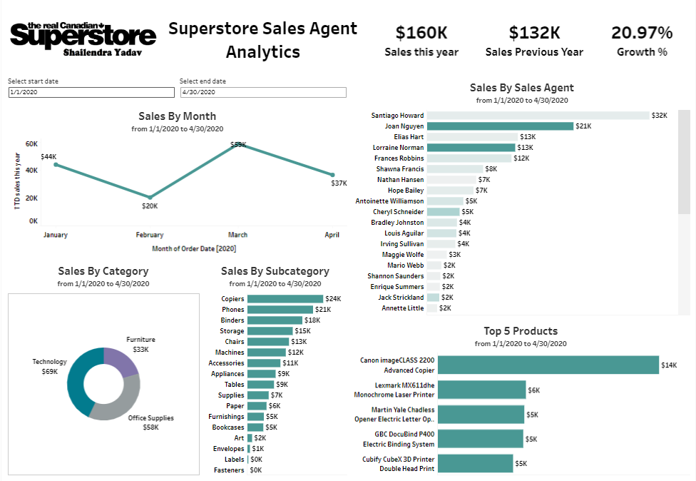

Slide 8
Project Brief: Northwind Trade
Objective
Northwind trade is a company which ships a variety of FMCG (fast moving consumer goods) all over the world.
The shipping manager doesn't have much visibility and doesn't know how many orders are processed and shipped on a monthly basis. He would like a dashboard of this where he selects a month and can tell how many orders are outstanding a day and where they should be shipped.
Northwind trade has a database on azure as well as maria db. The shipping manager has given us the details to connect to it.

Slide 9
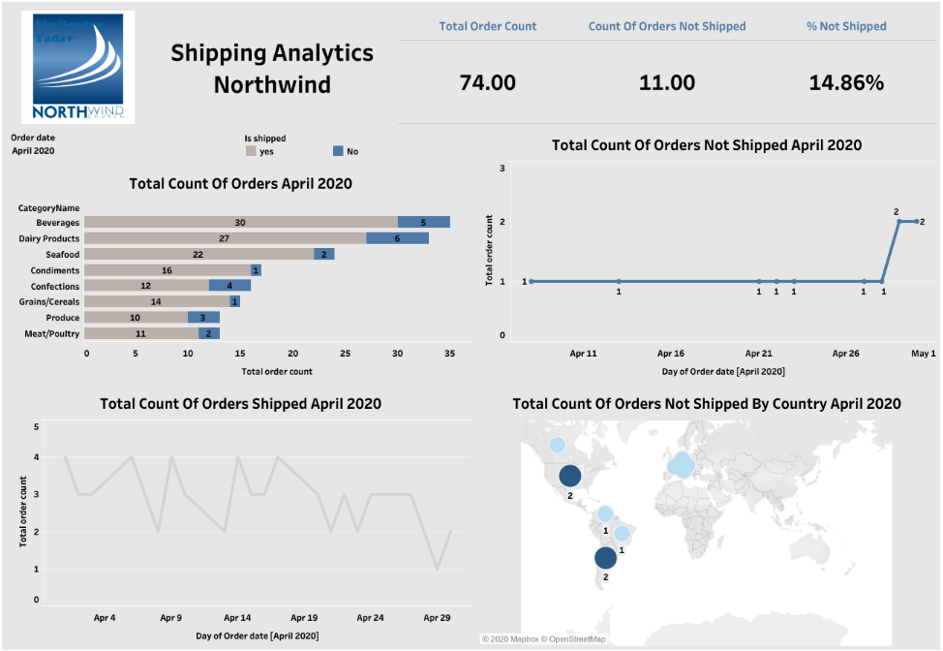

Slide 10
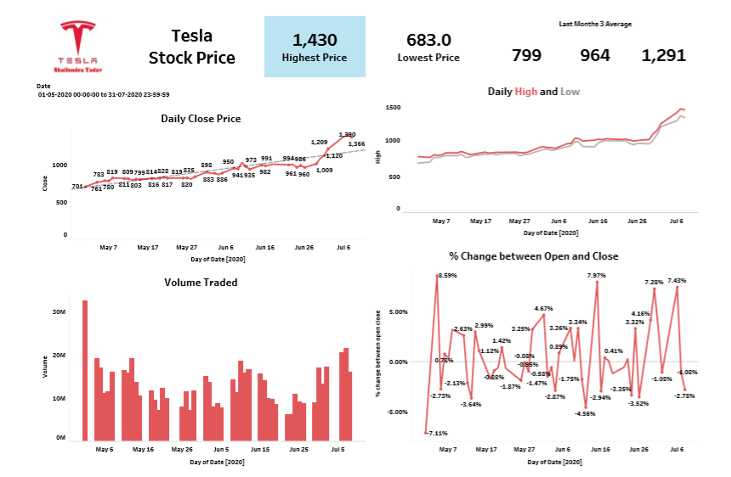

Slide 11
Thank you

